Slide 1
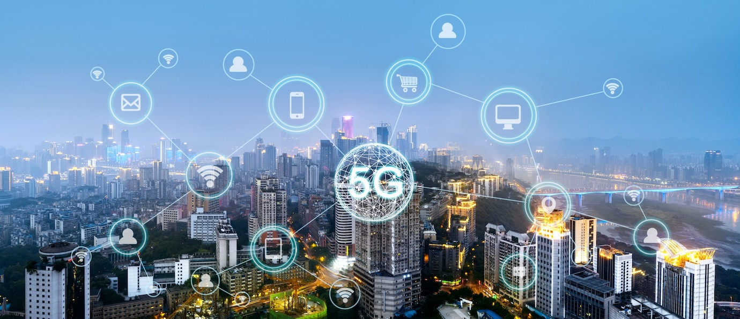

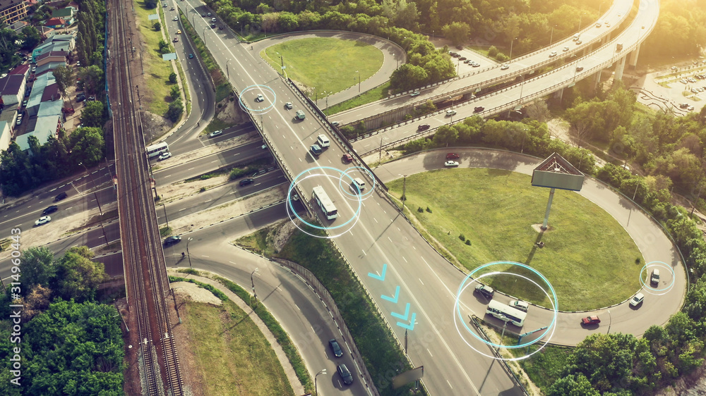

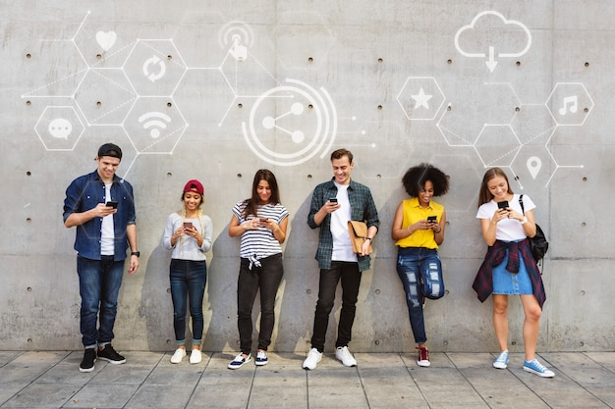
There are 5 unlimited opportunities for future economic development.
As a result of development and their citizens can access 5G widespread in Hongkong.
Smart City
Enhance safety
Productivities and Entertainment
Virtual Shopping
Medical services
-Smart Home / Smart buildings
-Smart metering and smart grid management
-Provide personalized shopping experiences through Virtual Reality (“VR”) or Augmented Reality (“AR”) technology
-Assistance from virtual staff
-Enhance safety and efficiency and alleviate traffic congestion through intelligent transport systems
-Real-time command and control for cellular drone communications
-Smart home monitoring systems to provide better care for elderly people living alone
-Remote monitoring of health conditions and medical consultations
-Real-time interaction and translation for participants speaking different languages
-Enhance the possibility of remote control of equipment in remote and relatively inaccessible areas

